Slide 1


Project Phase-1 Idea Presentation
Real-Time Imaging and Rapid Response System with Autonomous Drones for Military Applications
Team Members:
Mahaan N Bhat - 4SF2CD015
Zeeshaan S Shaikh - 4SF21CD032
Siddharth S Naik - 4SF21CD03
Under the Guidance of:
Dr. Navaneeth Bhaskar
Associate Professor
ISE/ CSE(DS), SCEM
Department of Computer Science and Engineering (Data Science)

Slide 2
Contents
Problem Description
Objectives
Proposed Methodology
Scope of the Work
Conclusion

Slide 3
Problem Description
Drones are increasingly being utilized in military applications, leveraging the latest advancements in technology. However, there is currently no comprehensive solution for real-time imaging, intruder detection, and autonomous decision-making. Existing systems lack the capability for drones to make independent decisions without human intervention. Additionally, in critical situations where an injured person needs immediate medical attention, there is no existing solution for the rapid transport of essential supplies, such as medicines or kits that require cold storage.
There is a need for a military-purpose drone technology system that integrates real-time imaging, intruder detection, autonomous decision-making, and rapid transport of essential supplies, such as medicines or cold-storage kits.

Slide 4
Objectives
Primary Objective: Develop an autonomous drone for military use, capable of real-time decision-making and mission execution.
Surveillance Capability: Perform aerial reconnaissance with advanced cameras and sensors to gather critical intelligence and monitor strategic locations.
Imaging Technology: Equip drones with visual, thermal, and night vision capabilities for surveillance, reconnaissance, and operational monitoring in diverse military environments.
Logistics Support: Deploy drones to deliver essential supplies and equipment to remote military outposts using GPS navigation and obstacle avoidance systems for precise logistics operations.
Intruder Detection: Enhance security measures by detecting and monitoring unauthorized intrusions into military installations, enabling rapid response and threat assessment.
Technology Integration: Utilize Jetson Nano for processing real-time data and guiding drone operations, ensuring efficient deployment and successful missions.

Slide 5
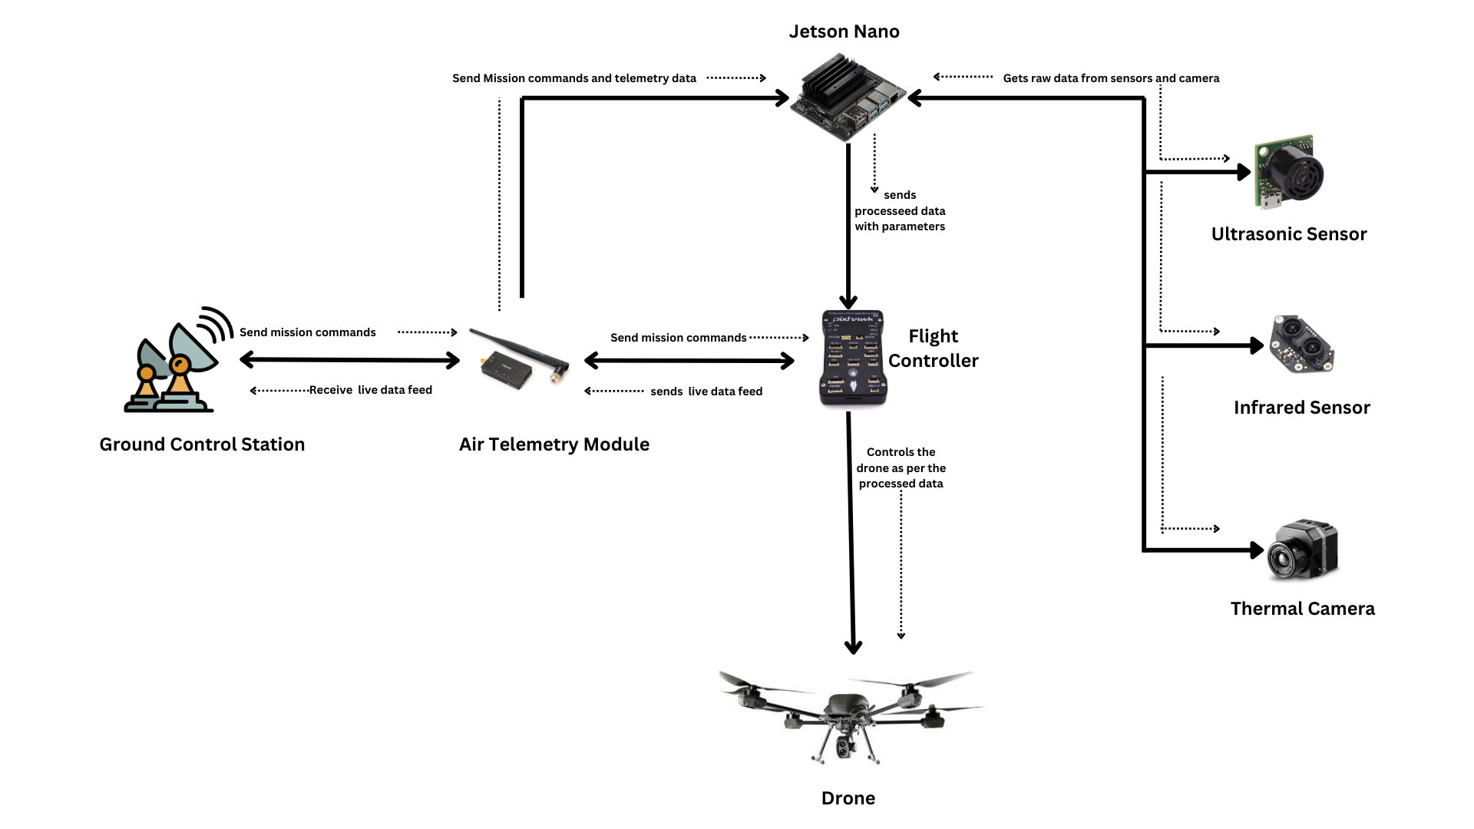
Proposed Methodology
Fig 1: Block diagram of proposed system
Block diagram of the proposed work

Slide 6
Proposed Methodology
Mission Coordination and Flight Management: Telemetry modules receive mission instructions for optimized flight paths, managed by flight controllers for stability and efficiency in complex environments.
AI-Powered Decision-Making and Navigation: Nvidia Jetson integrates OpenCV and machine learning for real-time processing of detection and imaging tasks, enabling autonomous decision-making and precise navigation across diverse terrains.
Versatile Military Applications: Advanced sensors enable real-time surveillance, rescue missions, and environmental monitoring. Capable of delivering payloads and detecting intrusions, enhancing military operational readiness and response capabilities.

Slide 7
Scope of the Work
Autonomous Navigation System: Utilizes onboard sensors, including GPS, Lidar, and IR, for obstacle detection, path following, and independent navigation without human control.
Real-Time Imaging and Sensor Integration: Integrates high-resolution cameras and sensors to provide real-time visual, thermal, and night vision imaging for various applications.
Artificial Intelligence Integration: Uses Nvidia Jetson and machine learning algorithms for autonomous decision-making, object recognition, and advanced navigation in dynamic environments.
Increased Payload Capacity: Designed to carry larger payloads, extending operational capabilities for transporting essential supplies to remote or hard-to-reach areas.
Continuous Improvement and Upgrades: Subject to ongoing enhancements, incorporating new technologies and refining components to maintain leading-edge functionality and efficiency.

Slide 8
Conclusion
This project aims to develop a fully autonomous drones equipped with advanced real-time imaging, AI integration, and payload capacity tailored for military applications.
By leveraging state-of-the-art technologies in autonomous navigation, sensor integration, and artificial intelligence, this drone will enhance surveillance missions, enable rapid medical supply transport, and improve overall mission effectiveness for military purposes.
The comprehensive scope of work ensures the drone will meet stringent safety and operational standards, providing a reliable and versatile tool for military use.
This innovative solution addresses critical gaps in current drone capabilities, paving the way for more effective and autonomous military operations.

Slide 9
Thank You

